Slide 1
This Week Work Progress
Lecturer：SUSTech Li Yuchen
2019.1.18

Slide 2
content
01
Reading paper & Recurring paper
02
Migrating to DR data set
03
Studying machine learning

Slide 3
Reading paper & Recurring paper
Part One
01

Slide 4
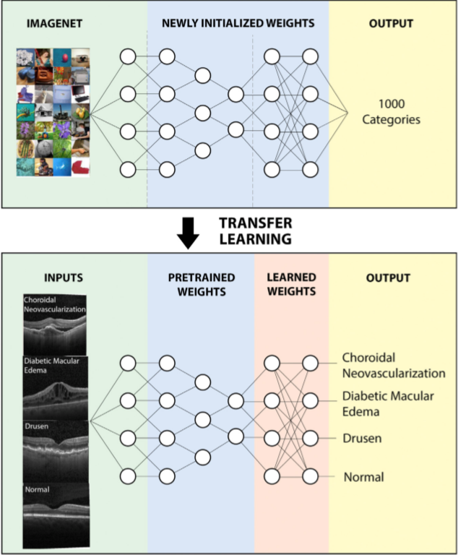
Cell: Identifying Medical Diagnoses and Treatable Diseases by Image-Based Deep Learning

Slide 5
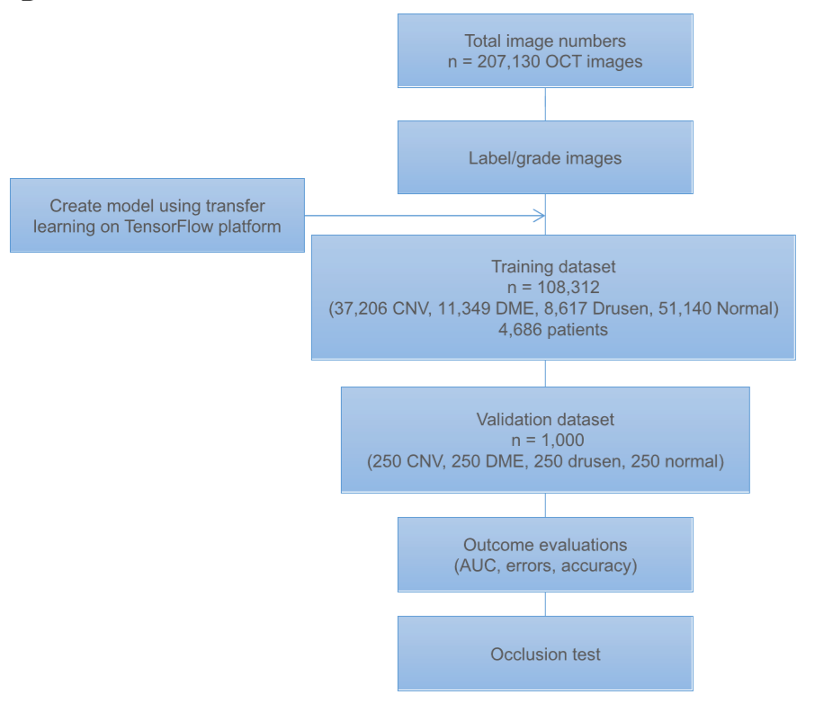
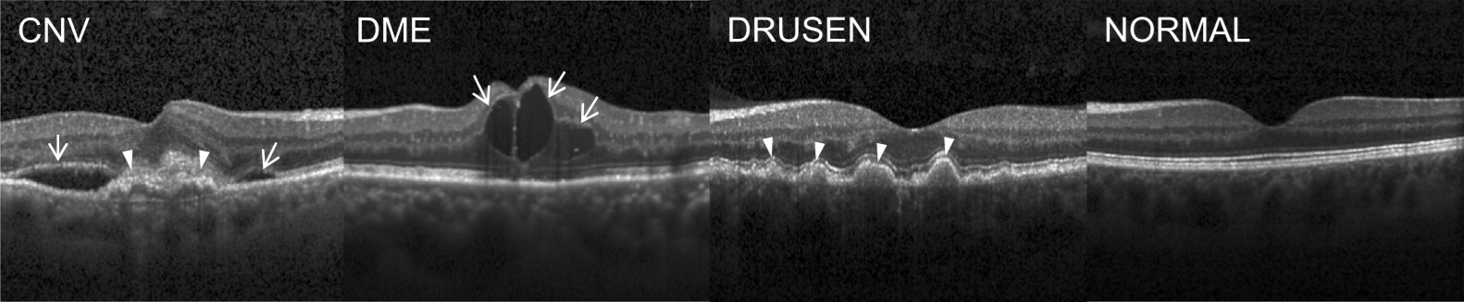
Macular Degeneration and Diabetic Retinopathy（OCT）
age-related macular degeneration
XRray
training：Normal：1349
PNEUMONIA：3884
test：Normal：234
PNEUMONIA：390
age-related macular degeneration
age-related macular degeneration
CNV: Choroidal Neovascularization 脉络新生血管
DME: Diabetic macular edema 糖尿病性黄斑水肿
DRUSEN: Multiple drusen present in early AMD
(age-related macular degeneration)

Slide 6
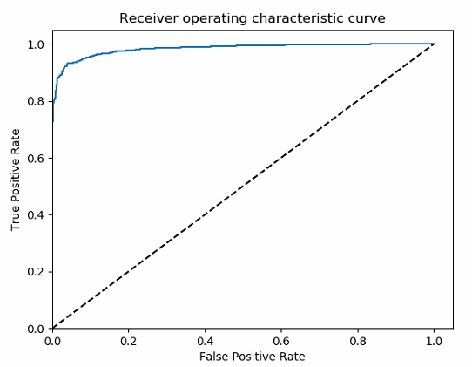
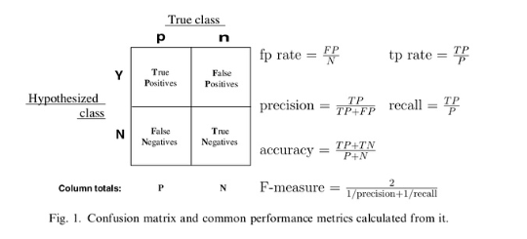
Effectively Classified images for macular degeneration and diabetic retinopathy
INFO:tensorflow:
Best validation accuracy =
97.29999899864197
INFO:tensorflow:
Final test accuracy =
90.85752367973328

Slide 7
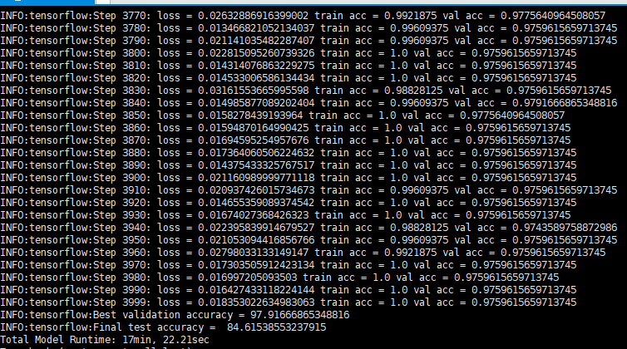
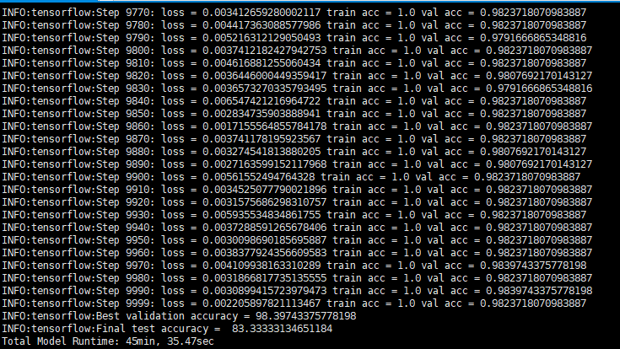
It also accurately distinguished bacterial and viral pneumonia on chest X-rays

Slide 8
Migrating to DR data set
Part Two
02

Slide 9
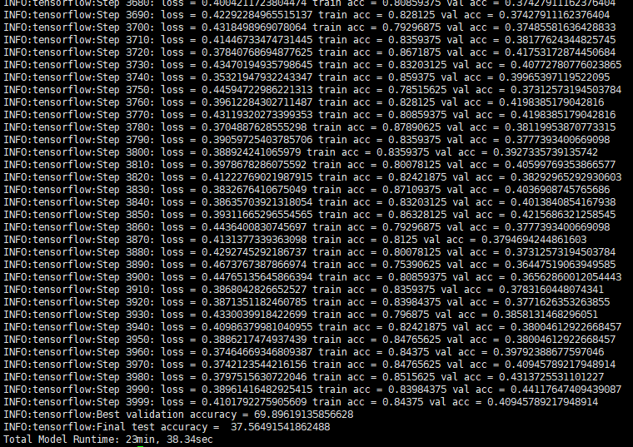
Migrating to DR data set
DR! left: 1259 right：1348 all: 2607
DM not DR left:2950 right:3107 all:6057
train: test: val == 6: 2: 2
755 808 | 252 270
1770 1864 | 590 621
1770 1864 | 590 621

Slide 10
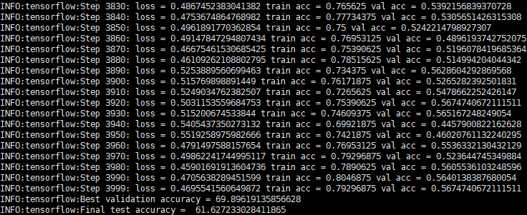
Migrating to DR data set
DR! let: 1259 right：1348 all: 2607

Slide 11
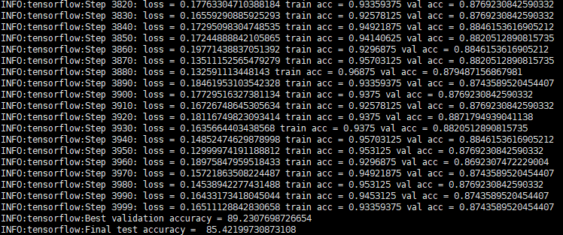
散瞳切过黑边的

Slide 12
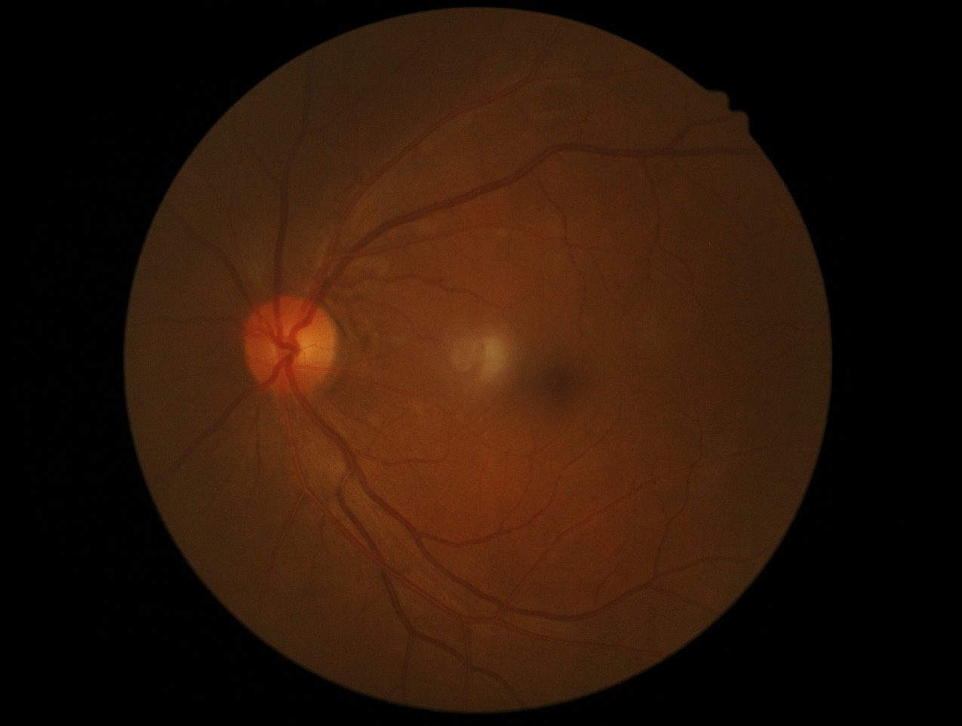
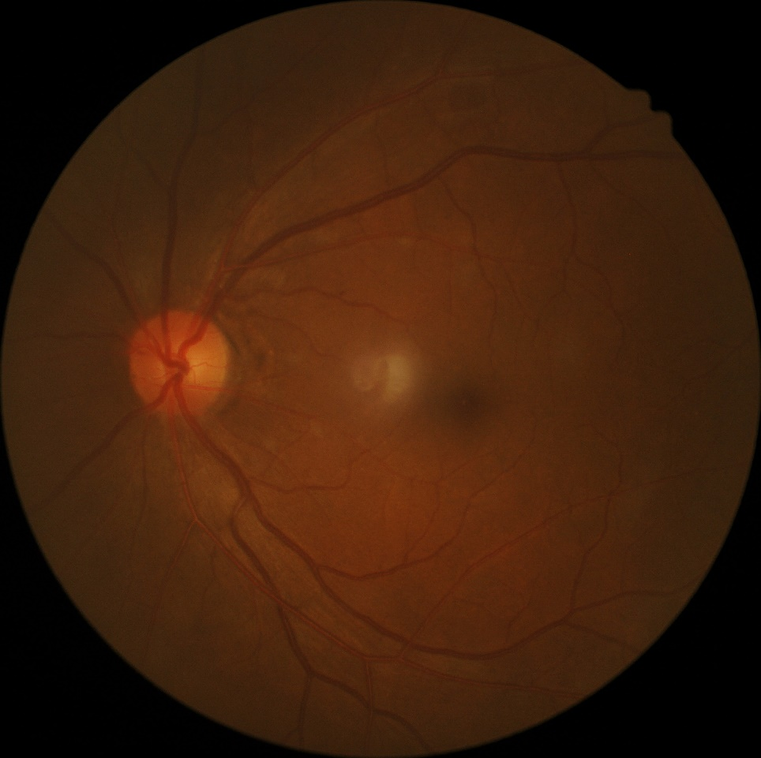
Remove the black edge of the image

Slide 13
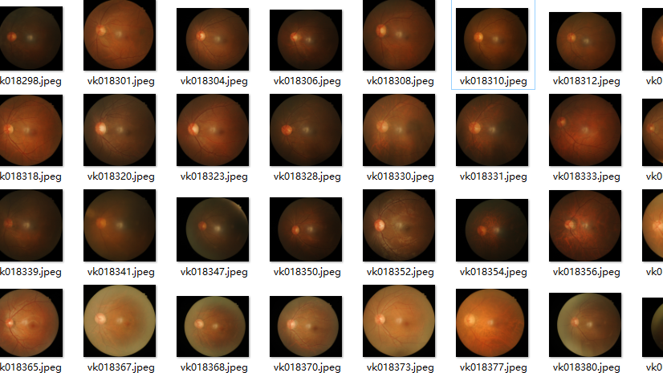
Problems
Best validation accuracy = 58.95237922668457
Final test accuracy = 50.67698359489441

Slide 14
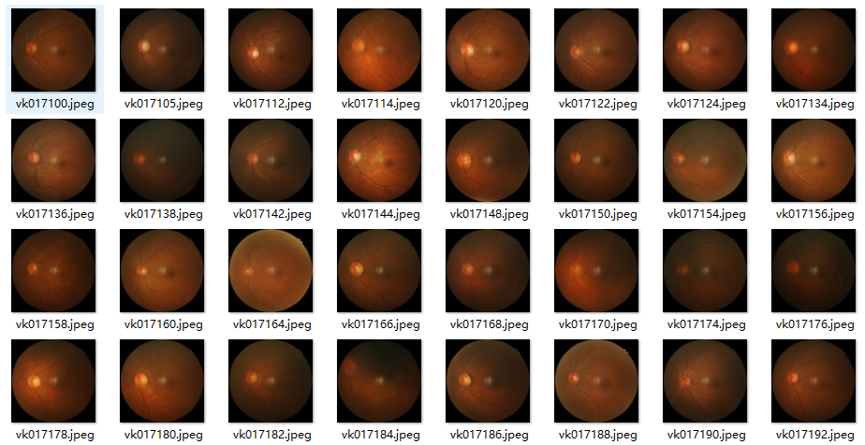
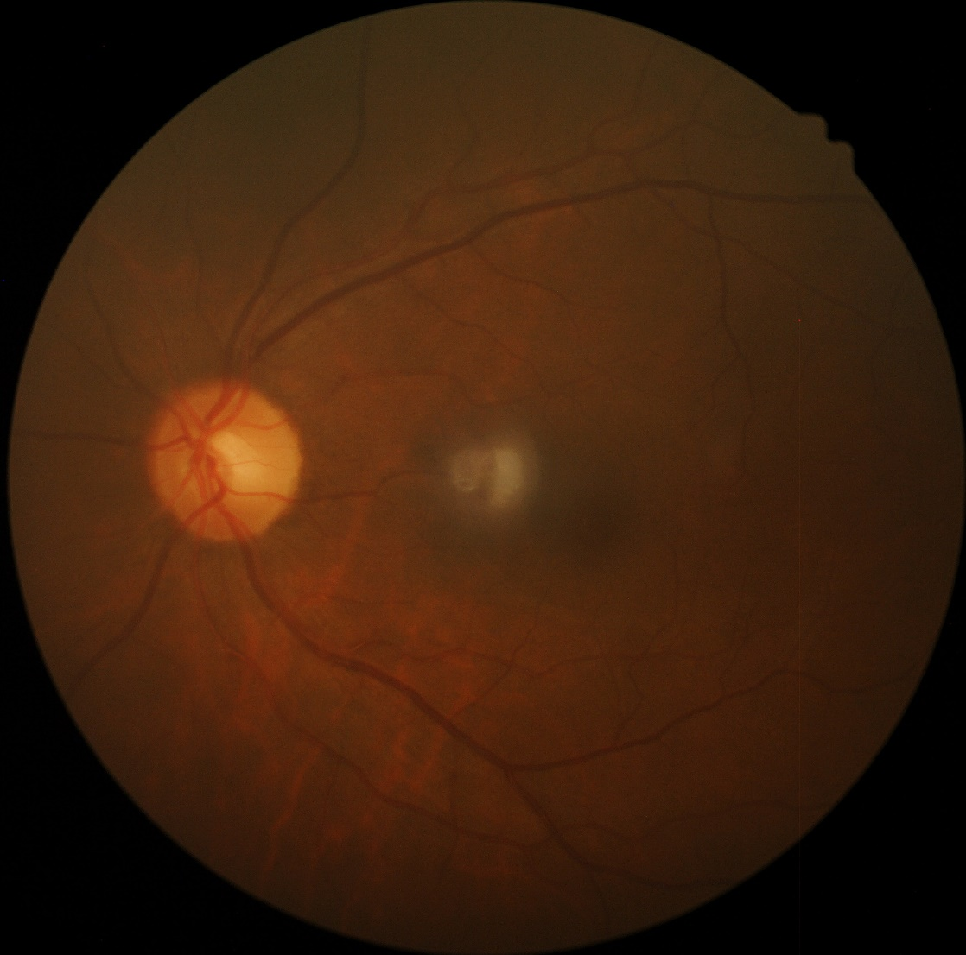
Unified the Size of Segmentation
According to 500 images average sizes to make a rectangle

Slide 15
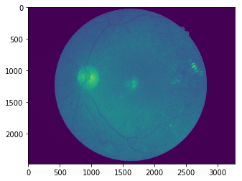
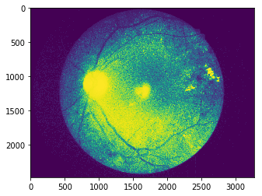
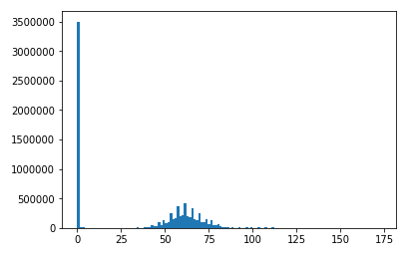
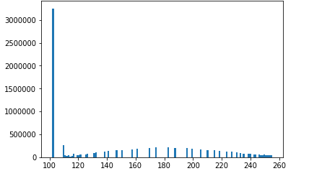
Some image processing of the picture
1、直方图均衡化

Slide 16
Study
Part Three
03

Slide 17
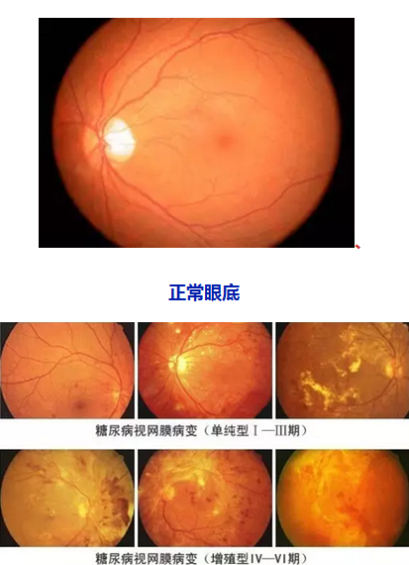
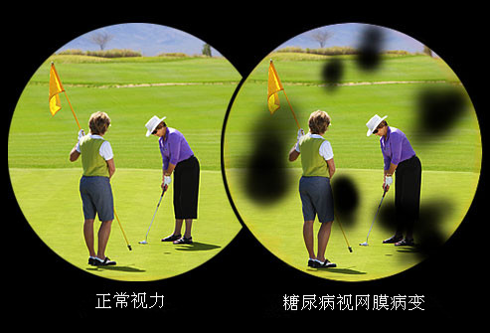
About Diabetic retinopathy

Slide 18
Reading Books
《Programming Computer Vision with Python》 first two chapters
《Andrew Ng，Machine Learning》 first eight chapters

Slide 19
Future plan
01
Try to use Image enhancement
02
Add bounding box
02
Erosion and Dilation

Slide 20
THANKS
And Your Slogan Here.

